Slide 1
Maintaining Microwave Spectrometer
Olivia Cote
Stephen Kukolich, Kukolich Lab, Chemistry Department of University of Arizona
27th Annual Arizona Space Grant Consortium Symposium, University of Arizona
April 14, 2018

Slide 2
Intro / Outline
Kukolich Lab
Space Grant Undergraduate Research Internship
Expectations
Data Sheet & Analysis
Documentation
Troubleshooting & Integration
Foundations Laid for the Future

Slide 3
Kukolich Lab
Source: Adam Daly

Slide 4
Expectations
Source: Huffington Post

Slide 5
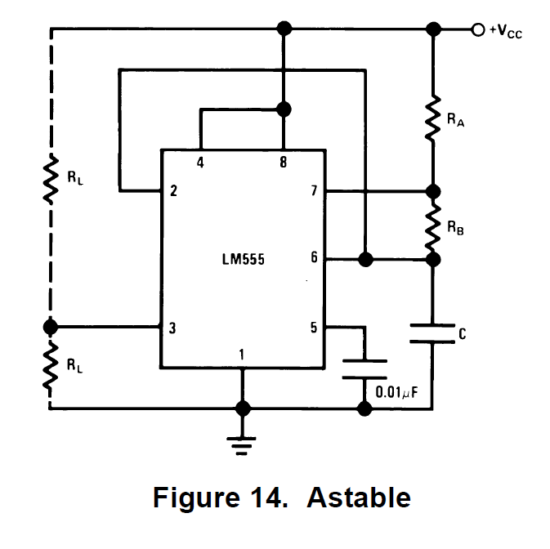
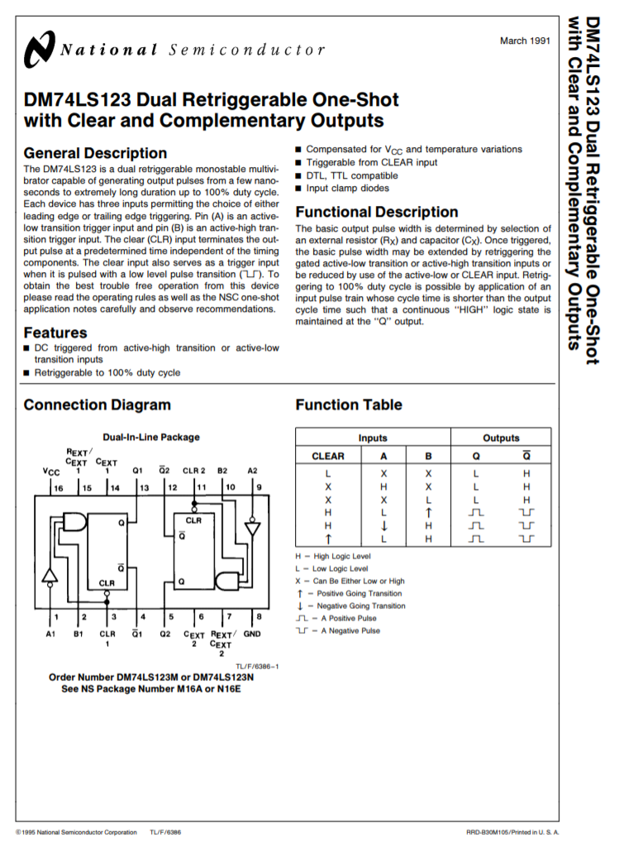
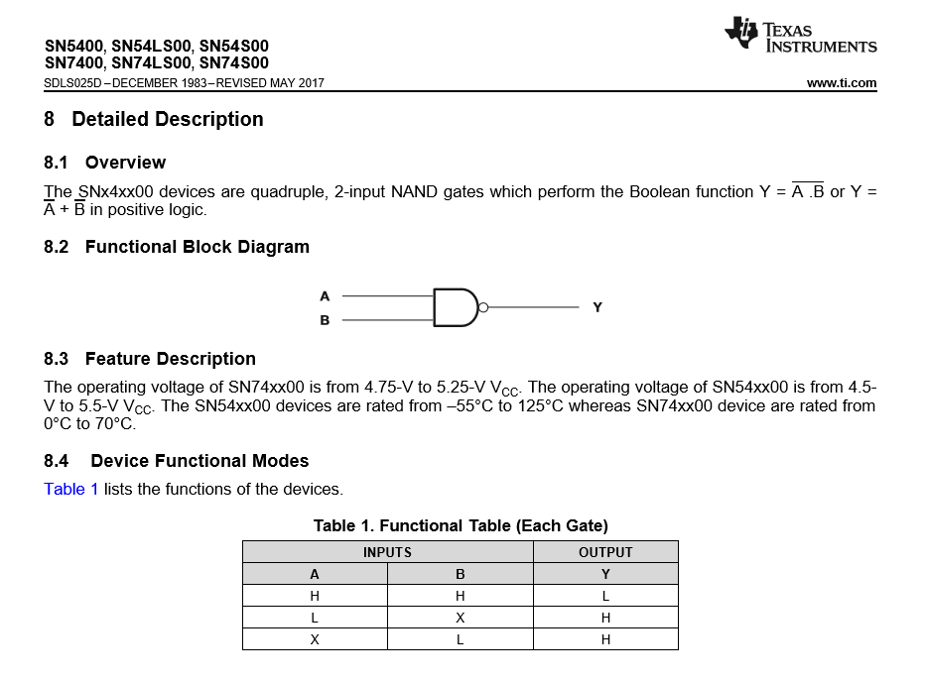
Data Sheet & Analysis
Source: Huffington Post

Slide 6
Documentation

Slide 7
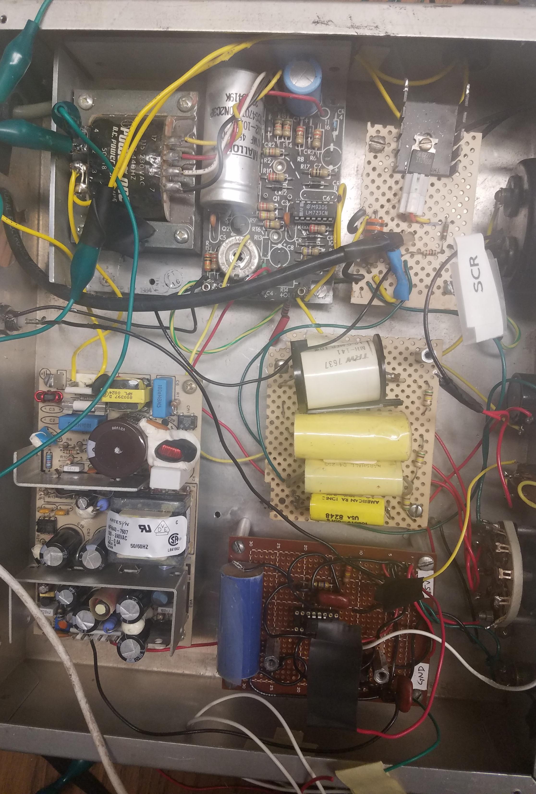
Troubleshooting & Integration
Desk Test Equipment
Multimeter
Oscilloscope
Power Generator
Special Tests Development & Implementation
Breadboard Modeling

Slide 8
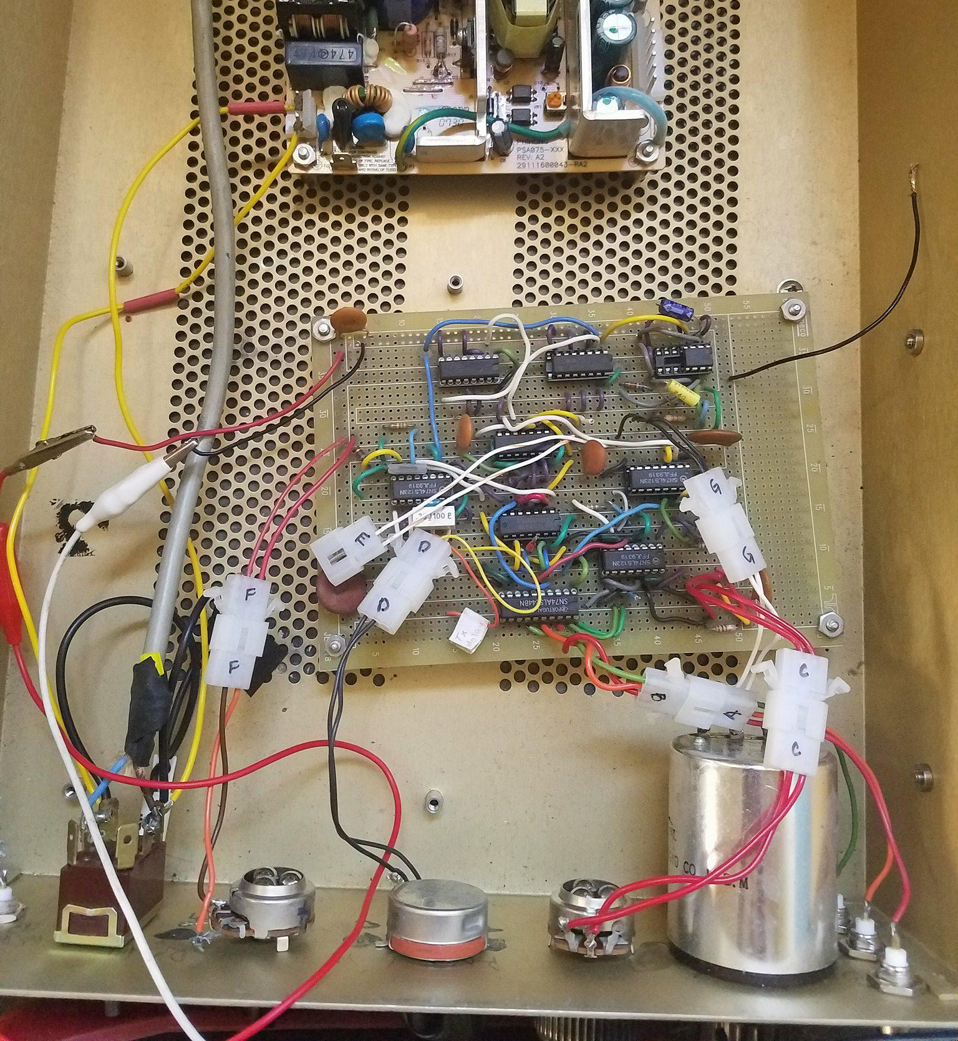
Troubleshooting & Integration
Troubleshooting Process
Check most basic things first – hot, ground, etc.
Simplify tests - LEDs
Assume you’re wrong – double check calculations, wiring set ups

Slide 9
Foundations for Future
Thorough documentation for easy transition for next person
Possibilities for future solutions
Completely software based replacement
Arduino microprocessor replacement

Slide 10
Thank you

